Slide 1
Orientation will begin soon
Do you have a ballot?
While you are waiting...
Please review the
Description
Goals
on the back of the Tab Ballot.
Notes:
(This slide can remain up while Judges are gathering to receive orientation. The Orienter can point out the relevant document.)

Slide 2
Notes:
Welcome to Stoa Speech Judge Orientation. Our goals today are to introduce ourselves and to better equip you as a Stoa Speech Judge.

Slide 3
“…trains Christian, homeschooled youth in speech and debate, in order to better communicate a biblical worldview.
National
speech & debate league
Homeschool students
Ages
12 - 18
100+
tournaments
each year
Notes:
Stoa trains Christian, home schooled youth in speech and debate, in order to better communicate a biblical worldview. Stoa offers approx 100 tournaments around the country throughout each competitive season.

Slide 4
This orientation
will explain…
The speeches
The setting and responsibilities
The ballots
Thank you for coming to judge
Notes:
In this orientation, you as the judge, will learn your responsibilities as a judge, what to expect when you go to the competition room, the types of speeches, and how to fill out the ballots.

Slide 5
Notes:
Here are the Speech events that may be offered at a Stoa tournament to give you a better understanding of what you will be asked to judge. We will give you a brief overview of each of these categories, but please remember to read the Goal, Description, and the Presentation Rules on the back of your Tabulation Ballot for more details.

Slide 6
A prepared speech, written and memorized by the competitor to:
Inform
Entertain
Persuade
Expose
Inspire
Note: Expository allows visual aids
Notes:
First, we have the Platform events. These events are probably what most people think of as public speaking.
All of these events are prepared speeches, written by the competitor.
Each speech must be memorized.
The purpose of the Platform speeches are to inform, entertain, persuade, expose, or inspire. Expository Speaking allows the use of visual aids.

Slide 7
Speech prepared on-site
Judges are provided a copy of topics/questions
Prep time & speaking time varies for each event
Please see the event rules
Notes:
You may judge a Limited Preparation event. In these events, competitors get a limited time to prepare a speech on a topic that is given to them at the beginning of each round.
These speeches must be prepared during the prep time.
The judges will be provided a copy of the topics or questions.
Prep time and speaking time varies for each event. Please see the event rules.
The Limited Prep Events will include Apologetics, Extemporaneous Speaking, Impromptu, and Mars Hill.

Slide 8
Apologetics
Mars Hill
Content is key!
Topics are theological in nature
Defense of faith
May or may not be evangelistic
Judges must agree with the
Stoa Statement of Faith
Copy available at end of slides
Topics are from media such as books, movies, songs, etc.
Common themes found in cultural references
Compare and contrast with biblical truths
Conversational delivery
Notes:
Apologetics is a reasonable defense of the truthfulness of Christianity.
The goal of Apologetics is to communicate a thoughtful and intellectual analysis of a question of faith or theological truth to others.
Speeches are targeted to an audience that may or may not accept the Bible as truth.
The presentation should be a thoughtful response to the question/topic and the reason(s) why it is important for theological truth and Christian living.
Before considering a ballot for Apologetics, please read through our Stoa Statement of Faith. If you are able to affirm these statements, then please feel free to request an Apologetics ballot from our ballot administration. If you are unable to affirm these statements, we request that you consider judging one of our other speech event categories. A copy will be available at the end of the slides.
In Mars Hill:
The topics are forms of media.
The speakers identify common themes with the cultural viewpoints from books, movies, etc
Then, speakers compare and/or contrast those themes and viewpoints in light of Biblical truth.
In Apologetics and Mars Hill, content is key. Please give more weight to the content of these speeches than the presentation style.

Slide 9
Impromptu
Extemporaneous
Wide variety of topics
Demonstrates on-the-spot thinking
Communicates theme and topic in a memorable way
The prompt must be the central theme of the speech
Questions about recent news stories
Analyzes current events using a variety of sources
Takes a position on topic
Assigned order and speaking times
Notes:
In Impromptu:
There is a wide variety of topics.
Demonstrates on-the-spot thinking.
Communicates theme and topic in a memorable way.
Speakers have two minutes to create a speech on a wide variety of topics.
They can take notes on a blank piece of paper but may only hold their topic slip while they speak.
In Extemporaneous Speaking
The competitor gives a speech answering a current event question.
Analyzes current events using a variety of sources.
Takes a position on the topic and supports it with analysis and evidence.
Prep time for extemp is done BEFORE the student enters the room.
Prep time for extemp is done BEFORE the student enters the room.

Slide 10
Select and analyze literature
Bring to life through:
No costumes or props
voice
movement
facial expression
Notes:
Next we have the Interpretive Events.
Using literature, competitors bring the story to life through creative use of voice and movement without the use of costumes or props.

Slide 11
Should be plot based
May be
self-written
Should be plot-based
Lighthearted
Serious
Serious or lighthearted
2 speakers
1 speech
No direct contact
Notes:
Using literary sources, all Interpretations create an original rendition of a selection.
Dramatic, Humorous, and Duo interpretations should be plot-based literature.
In Dramatic, Humorous, and Duo Interpretations, competitors focus on plot and character development, portraying a realistic journey of one or more characters with a diversity of emotion.
In Humorous, competitors focus on conveying a story humorously, but the presentation should not be stand-up comedy.
In Dramatic, competitors focus on presenting a story that is serious innature which captivates and moves the audience. A Duo interpretation will showcase two students delivering one story which may reflect a wide range of topics and/or emotions. It can also be created using multiple literary sources.
An Open Interpretation can be a monologue, a story, a poem, or an original work written by the student, and may reflect a wide range of topics and/or emotions.

Slide 12
Slam Poetry
A thematic expressionistic presentation of poetry
Poetry may be original, published, or a compilation of the two
Vocal variety with limited movement
Audience may participate with snapping and/or clapping
Notes:
Stoa offers Wildcard events that run for two year terms.
Our Wildcard event is Slam Poetry.
Using a poem or a selection of poems, a speaker will convey a single theme through an expressionistic and engaging presentation that portrays the meaning of the poetry and the poems’ artistic language.
It may be original or published or a compilation of both.
Audience members may participate with snapping and/or clapping.

Slide 13
Notes:
(slide to pause and ask for questions) Any questions regarding the events or where to find the event rules?

Slide 14
JUDGES
You can do this!
Be responsive! You are the audience
Set aside personal bias and expertise
We want your opinion!
Please, don’t consult with other judges or audience members
Give feedback that will motivate and educate
Don’t discuss speech content with speakers
Notes:
The greatest objection we hear from our judges is that they feel unqualified. Our response:
You can do this! This training, along with our ballots, is designed to give you the tools you need so you can be better prepared to judge.
Please be responsive! As the audience for each of these competitors, you are a source of encouragement. You do not need to be expressionless. Feel free to nod, smile, and laugh. The more you respond, the better they will perform!
We do ask our judges to set aside any personal bias and expertise. While you may be an expert in a given field, please don’t judge a competitor's speech on your knowledge but on the research they present.
While we encourage you to be friendly and greet each competitor, there should be no discussion with speakers about their presentations.
Multiple judges are likely to be in each room; however, judges should not consult with one another regarding student evaluation and ranking. We want the opinion of each individual, not a collaborative decision.

Slide 15
Sit at assigned judge table and turn off your phone
Wait for all the judges before starting the round
Audience members may come and go between speakers
Head Judge controls the timer (facing competitor) and confirms penalties
Stay until every competitor has presented
Competitors may speak out of listed order (Extemp is an exception)
After the round, complete your ballot in the Judge Hospitality area
Notes:
Please sit at the assigned judge table and remember to turn off your cell phone. If you require anything, tournament staff will assist with missing ballots, room issues, or any other needs. The assigned table will have a large timer on it.
When you receive your ballots, you will be notified if we need you to be the “Head Judge”. The Head Judge will supervise the digital timepiece.
Since the competitors need to self-monitor their speaking time, please turn the room timepiece toward the competitor. Be sure the competitor can see it well. Further instructions for timing will be in the Room Administration document given to the Head Judge.
Be sure to wait for all judges before starting the round. If you are not sure how many judges are slated for that round, please verify with the tournament staff before hearing the first speech.
Stay in your room until every competitor has presented. Please take care of phone calls, visit the restrooms, or grab some water before getting to your room.
Competitors may speak out of the order listed on your ranking sheet as they sometimes compete in multiple events (except for Extemp). If you wait for more than 15 minutes for a competitor to arrive, please contact a tournament staff member for assistance.
Audience members may come and go between speakers.
And finally, trust your natural communication instincts. It's worth repeating, you really can do this!

Slide 16
Check for conflicts
Tabulation Ballot/Rules:
Rank the room
Student Ballots:
Evaluate the speech and provide feedback
Notes:
Judges will be given two types of ballots.
Please check all names on your Tabulation ballot for possible conflicts.
At each tournament, you may judge a speech event only once unless otherwise instructed by tournament leadership. You are allowed to judge a competitor in multiple events.
Each of the two ballots has a different purpose.
The Student Ballot is to evaluate and to provide feedback to each individual. The speaker receives this ballot at the end of the tournament.
The Tabulation Ballot simply shows how you ranked the speakers in the room from first to last. The speakers do not see this ballot.

Slide 17
Copy speaker, room, and round from Tab Ballot
Please use black or blue ink
Judge = you!
Jot down the topic
Duration = length of speech
No minimum time limits
Notes:
When filling out the Student Ballot, please use black or blue ink.
Copy the speaker name, room number, and tournament round from the Tabulation Ballot. And, of course, fill in your own name as the Judge.
There is a line here to jot down the topic or selection.
Duration is the length of speech. This time will be shared from the official timepiece at the end of each presentation. All judges record the official time.
Each event will note the maximum time limit, and there are no minimum time limits.

Slide 18
Use the ballot criteria to evaluate the speaker
Note unique criteria for specific speech events
Notes:
Notice the specific box designated to highlight unique criteria for different speech events such as the Platform events, the individual Interp events, and the Limited Prep events.
Once you have seen a presentation, evaluate the speech objectively using the ballot criteria.
Students use this criteria to write their speeches. Please do not impose your individual preferences on the speech.

Slide 19
Rate the student’s performance on “Evaluate” scale
The numbers are not used by the tournament to determine points or ranking
Record any penalties
Confirm penalties with Head Judge
If there are penalties, don’t circle student ranks - allow Ballot Return to assist you
Notes:
Once you have seen a presentation, please rate the student’s performance on their ballot using the criterion in the "Evaluate scale" column.
This is a basic scale indicating how the competitor measured up to these specific criteria. The numbers are not used by the tournament to determine points or rank.
Please note any penalties in this section and see staff at Ballot Return for help with reranking.
The Head Judge will confirm penalties with the other judges at the conclusion of the round.

Slide 20
In the comments section:
Provide feedback:
What worked
What didn’t
You are given 2 minutes between speakers to jot down your initial thoughts
You will have more time to complete your ballots after the round
Notes:
Use the "Comments section" to report what you saw in each presentation.
This is where you can educate the student with
what worked and
what didn’t work well for you.
To give time for notes, judges may set 2 minutes between speakers for platforms and interpretive events. Limited preparation events must use the next student’s prep time for comments. In Extemporaneous Speaking, the competitors have assigned speaking times and a pre-established order from which they may not deviate. Judges may use any available time between speakers to fill out ballots. Jot down initial feedback. You have plenty of time in the judge’s room later to finish your ballot comments and evaluation.

Slide 21
ORDERING
Mark Twain
Stack ballots to order speakers
Consider order without penalty
Notes:
The ordering of all the speakers can often be a challenge for judges. It can be so hard to decide first place when everyone seems so good!
To make this job relatively easy, we suggest stacking ballots to order speakers.
Please stack the ballots assuming there are no penalties, even if there are penalties.
Here is how it is done: Mark Twain is going to come into your room, and he gives a stellar presentation! He's got to be first! Actually, he really is, since he is the only competitor you have seen. So Mark's ballot gets placed first in your stack.

Slide 22
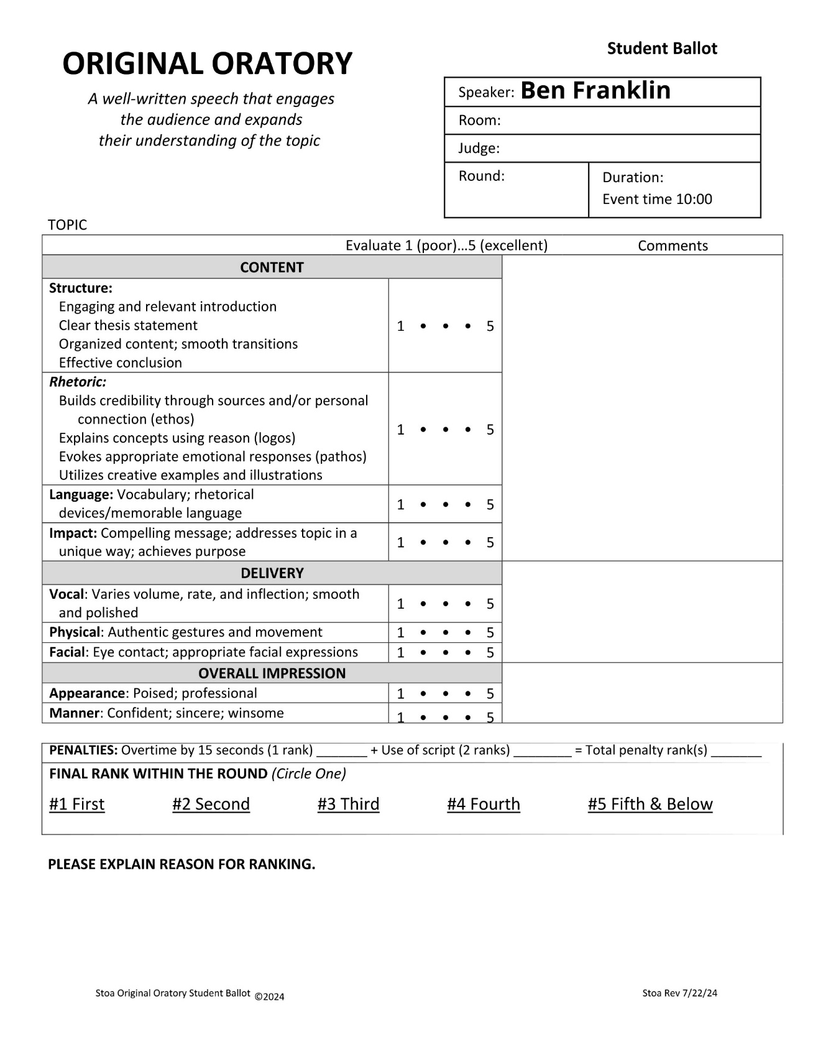
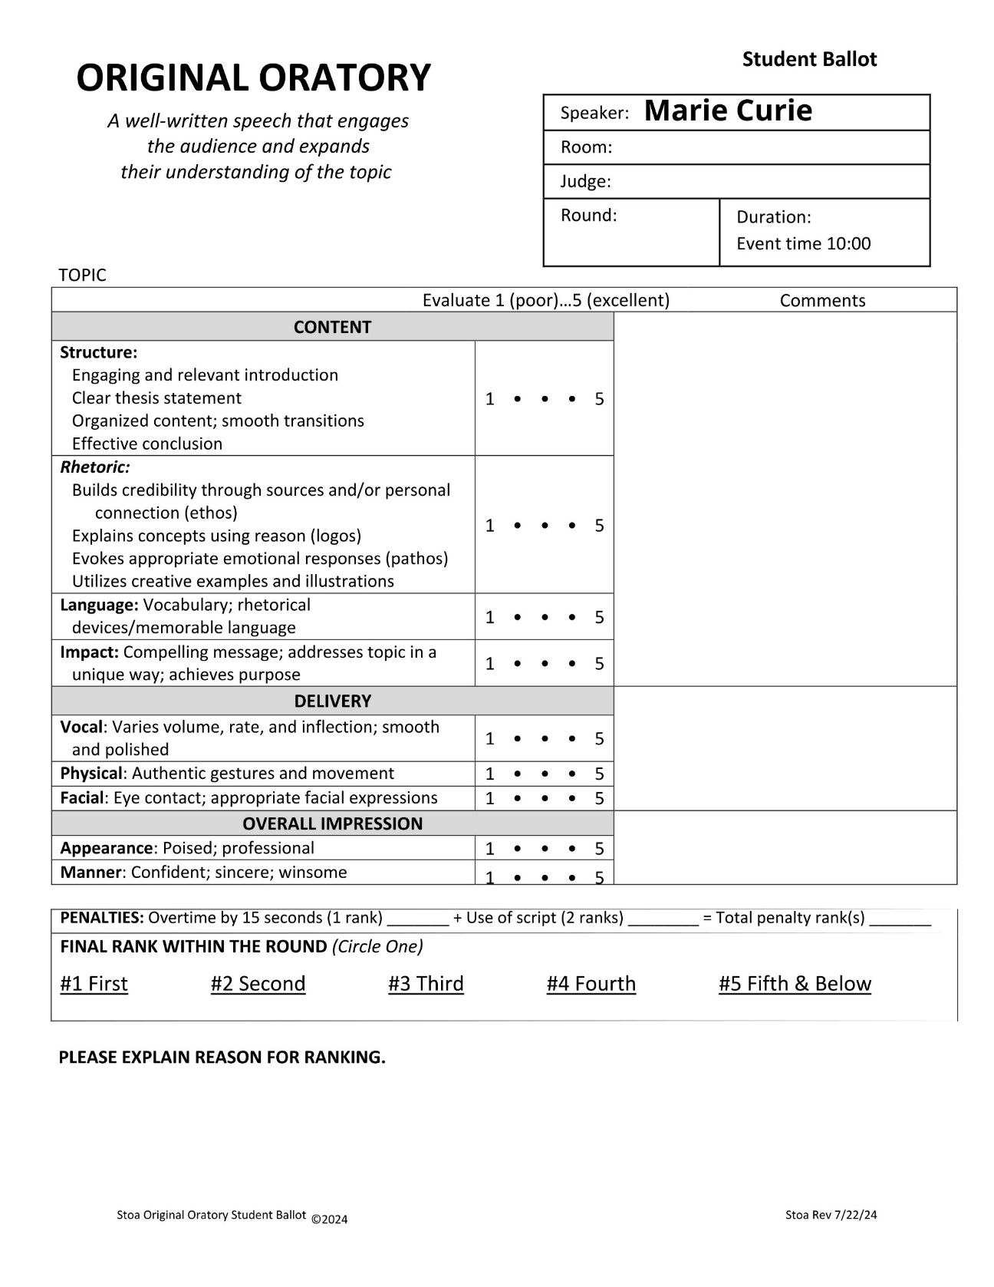
ORDERING
Mark Twain
Mark Twain
Consider order without penalty
After stacking, you have a general idea of your ranking
Notes:
The second speaker is Ben Franklin. Wow, he's excellent, too! But he's not quite as exceptional as Mark, so he slides into second place. I'm sure you see where this is going.
Third, Marie Curie comes into the room. She's also not quite as compelling as Mark, but she did communicate a little better than Ben, so she slides into second place, moving Ben down to third position. This method is helpful in establishing your speaker rankings. Just be sure not to drop your papers!!

Slide 23
After you hear all the speakers…
Confirm any penalties with the Head Judge.
Go to the Judge Hospitality area to finish your comments and complete your ballots.
Ask the Judge Orientation staff if you have any questions.
Complete the Tabulation Ballot before circling rank on the Student Ballot.
Notes:
After you have heard all the speakers, confirm any penalties with the Head Judge. We will explain the various penalties on the next two slides.
Please return immediately to the Judge Hospitality area to finish your comments and complete your ballots.
If you have questions, see one of the Judge Orientation staff.
Please do not circle the Final ranking on the Student ballot until the Tabulation ballot is complete.

Slide 24
Use Original Rank column to record speaker ranking based on how you ordered them
Number speakers from 1ˢᵗ to last
There can be no ties
Notes:
Review all of the Student ballot criteria, making sure you are satisfied with how you have stacked your ballots. Now you are ready to complete your Tabulation Ballot.
Use the Original Rank column to record your speaker order.
Number speakers first to last.
Remember, there can be no ties.

Slide 25
No penalties?
Carry forward to Final Rank
Notes:
If there are no penalties, just carry the numbers from the Original Rank forward to the Final Rank column.

Slide 26
With penalty:
Go to Ballot Return for assistance
Notes:
A penalty must be applied if:
The competitor goes 15 seconds or more overtime.
The competitor uses a script for Platforms or Interpretations
The competitor fails to state author and/or title for Interpretations
If there is a penalty
Notate in the Penalty column
See Ballot Return to complete

Slide 27
Circle Final Rank numbers on individual ballot
For ranks 5-8 circle “5ᵗʰ Fifth & Below”
Provide Reason for Ranking
Compare speakers within the round
Notes:
Now that you have completed the ranking of the room, it is time to further educate the individual speakers.
Complete any comments on your student ballots.
Tell them what they did well
and where they need improvement.
Please don't underestimate the impact this will have on each competitor. They really do crave constructive criticism to improve their skills.
At the bottom of the Student Ballot, circle the individual rank for each student.
While the Tabulation Ballot must have unique numbers for first through eighth place, each Student Ballot will be marked first through fourth, and for students ranking fifth through last place, you will circle the complete phrase, "5th and Below".
Finally, give the students a reason for their ranking compared to others in the round. The students are looking for what they could do to move up a rank in your evaluation. Your comments truly are valuable to them.

Slide 28
A few final reminders…
Before judging, read the description, goal, and presentation rules on the back of your tabulation ballot
If there are penalties, don’t circle student ranks until Ballot Return assists you
Once ballots are complete, take them to Ballot Return and wait as they review them
Judge Orientation staff will be available for questions
Have fun and know that you are serving an educational role for each student!
Notes:
Here are a few final reminders to help you feel prepared:
Read the Description, Goal, and Presentation rules on the back of your tabulation ballot before you begin judging.
The numbers 1-5 are never added up or used by the tournament staff. They are for your evaluation purposes only.
If there are penalties, allow Ballot Return to rerank before circling the final rankings.
Once ballots are complete, take them to Ballot Return and wait as they review them.
Please do not confer with the other judges concerning speaker evaluation or content. Any questions should be directed to the Orientation staff who will be available to assist you when you return to the judge hospitality area.
Have fun and know that you are serving in a vital education role for each student!

Slide 30
Notes:
Thank you for reading the Stoa Statement of Faith before considering an Apologetics ballot. Remember, if you agree with these statements please feel free to request an Apologetics ballot. If not, consider judging one of our other speech events.

