Slide 2
National
speech & debate
league
100+
tournaments
each year
Homeschool
students
Ages
12 - 18

Slide 3
We can’t do this without you.
You are making an investment.
You are performing a teaching role in the lives of our students.
You make it possible for young people to learn these skills.

Slide 4
You already participate in communication activities.
It is not your job to be a debate expert.
It is the speaker’s job to communicate to you.
Our goal is for our students to speak to “the thinking man and woman on the street”.
That’s you!

Slide 5
There is one judge in preliminary rounds.
The number increases in elimination rounds.
Debaters will time their own speeches.
There may also be a timekeeper.
Debaters will introduce themselves to you.
They may ask for your judging philosophy.

Slide 6
Two opposing teams argue an idea: the Resolution.
affirms the resolution
refutes the Government
(debaters alternate sides during the tournament)
Debaters do not choose the side of the resolution they will defend.

Slide 7
Parli is extemporaneous debate where students are challenged to develop argumentation with limited time for preparation.
Parli asks competitors to develop and defend ideas and positions on a wide range of issues.
Rather than formal evidence, debaters utilize information that is within the knowledge of educated and informed citizens.

Slide 8
Students receive a new resolution each round.
They do not know what the topic will be beforehand.
There are different types of resolutions.
The kind of resolution can be up for debate in the round.
Students are given “prep time” prior to the debate.
They are allowed to access resources during this time.
However, they may only bring handwritten notes, a copy
of the Parli rules, and a printed copy of the resolution into the round.

Slide 9
7 min. Prime Minister Constructive
7 min. Leader of Opposition Constructive
7 min. Member of Government Constructive
7 min. Member of Opposition Constructive
5 min. Leader of Opposition Rebuttal
5 min. Prime Minister Rebuttal
In Parli, there is no prep time between speeches.

Slide 10
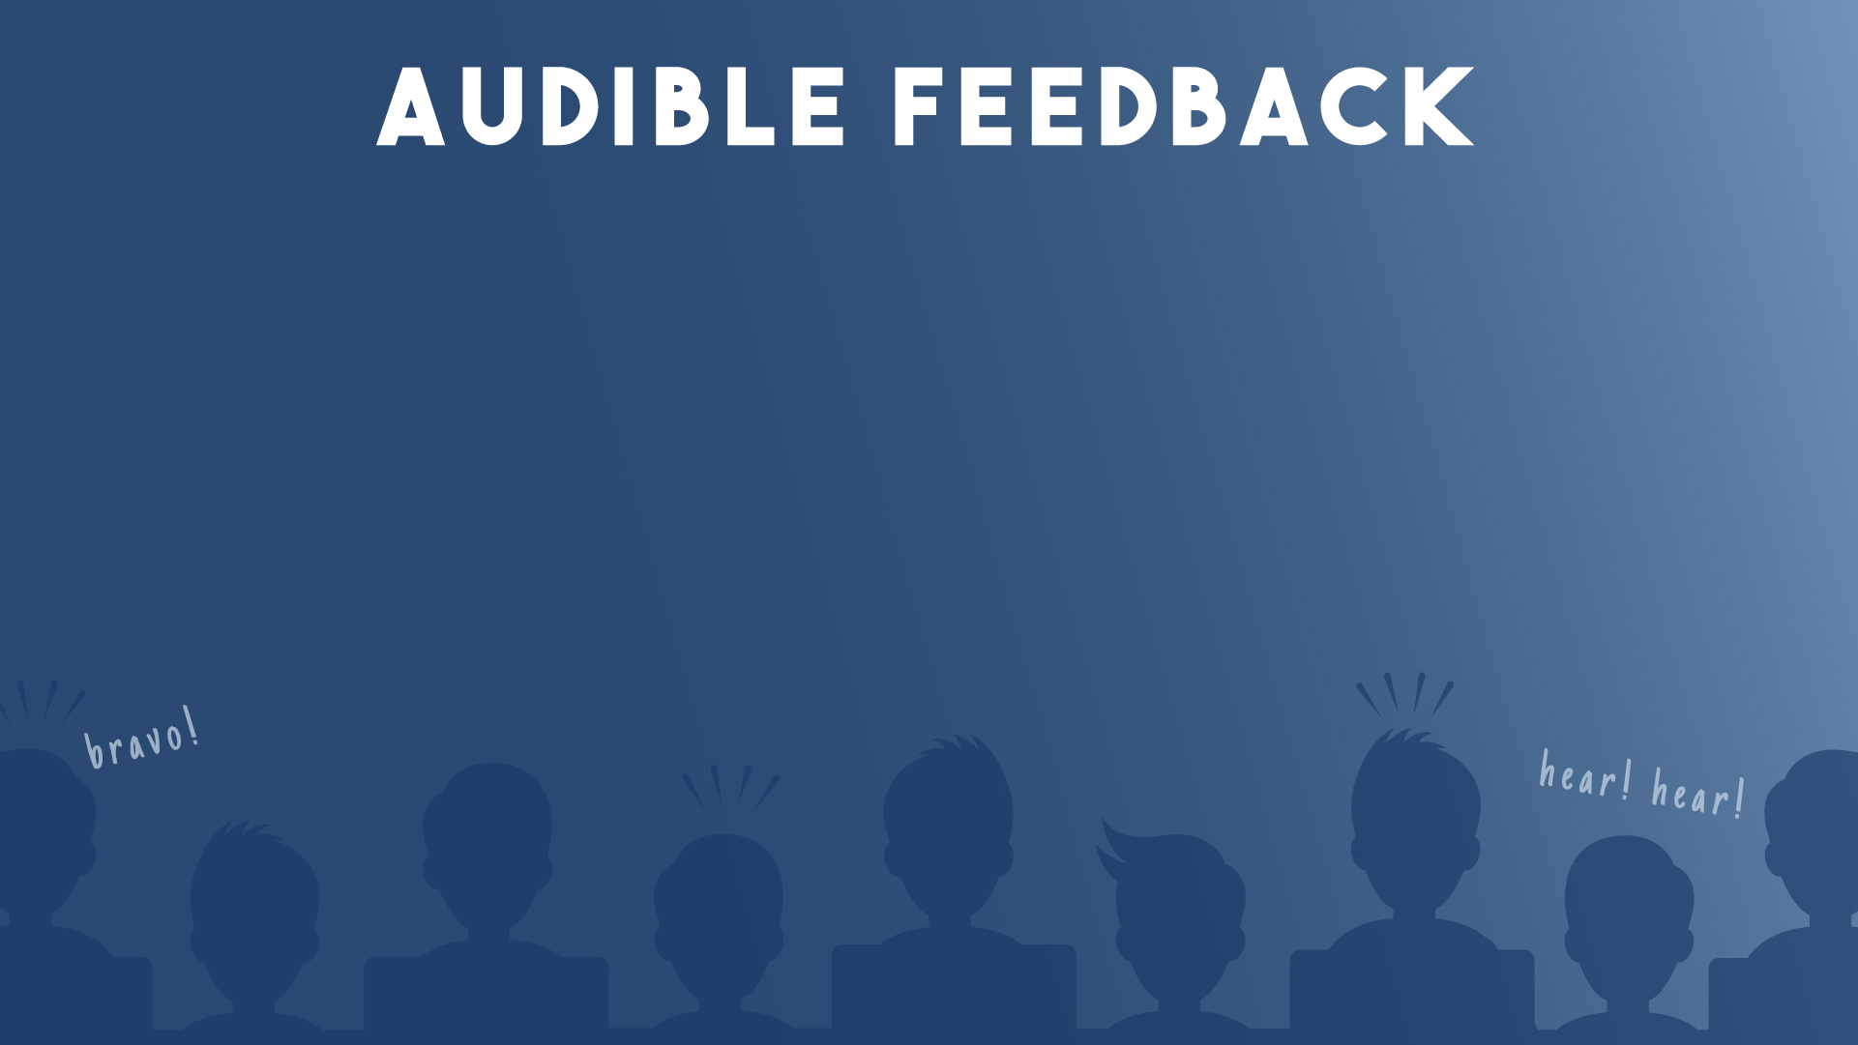
Because Parli is based on the British Houses of Parliament, judges and observers are allowed to provide audible feedback respectfully during the round.
Feedback should not be distracting or “drown out” the speaker.
Audience feedback should not influence the judge’s decision.

Slide 11
Debaters will make a variety of arguments which may be supported with:
logic
definitions
history
philosophy
applications
facts
analogies
examples
and other relevant information
All forms of support are valid, and the debaters may persuade you as to which types of support are best for the issues at hand.

Slide 12
Parliamentary debate is not evidentiary debate.
Debaters should utilize information that is within the realm of knowledge of educated and informed citizens.
Judges should disallow and disregard overly specific information.

Slide 13
Exchanges between the debaters during the round.
Interactions should be respectful and constructive.
Number of POI’s and POO’s will vary.
May or may not affect your ballot.

Slide 14
Occur only in constructive speeches.
Not allowed during protected time.
Debater rises and waits to be acknowledged.
Speaker at the podium has the right to decline.
Poses a question or makes a brief comment.
Timer does not stop for the exchange.
Does not require judge interaction.

Slide 15
Alleges an infraction of rules has occurred.
May happen any time during the debate.
Debater rises and says “point of order”
and identifies the rule violation.
Speaker must yield and respond.
Timer will stop for the exchange.
Judge may comment or not.
Judge may make a ruling at that time, or indicate
the conflict will be “taken under consideration”.

Slide 16
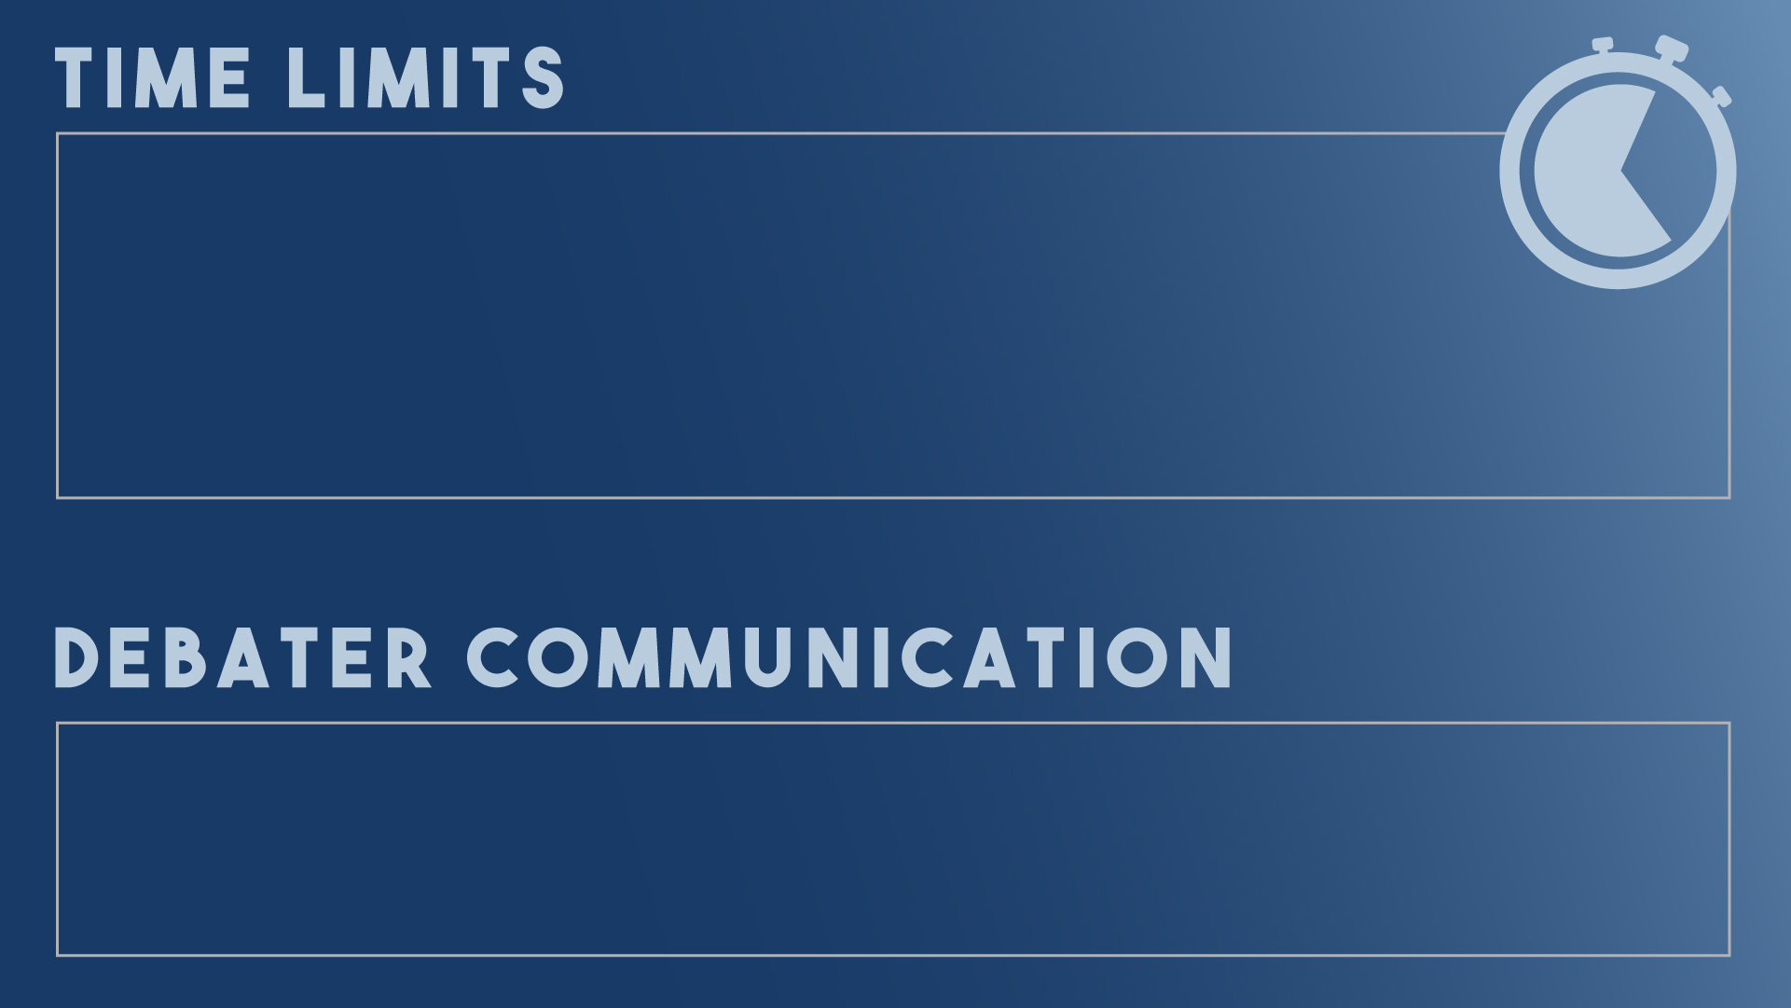
Once time expires, a debater may complete a sentence, but should not start a new thought.
Once time expires, judges should disregard the additional comments and content when evaluating the round.
Debaters may communicate and pass notes while at the table, or pass notes to their partner who is speaking.

Slide 17
Flowing organizes the ideas in a round.
Use flow sheets or plain paper.
Not to be turned in.
Optional! Just a tool to help you.
The right note-taking system allows you to:
Absorb the presentation.
Follow an argument as it’s developed.
Track responses & refutation.
Give the debaters written feedback.

Slide 21
The debaters are responsible for making their ideas clear to the judge, including:
Debate theory.
Organization of the ideas and arguments in the round.
Details of the topic.
It’s up to the debaters to persuade you how to vote, and why.

Slide 23
Do set aside your personal bias.
Do decide which team best supports their position.
Do provide written feedback.

Slide 24
DON’T interrupt or question the debaters during the round.
DON’T leave the room, text, or take phone calls during the round.
DON’T discuss the round with the debaters, audience or other judges when it is finished.

Slide 25
Confirm you have not judged either debater in this event at this tournament.
Make sure the tournament staff know which ballot you have.
Find the room number (top right).
Fill in your name (if needed).

Slide 26
Two independent decisions:
Decide which team wins.
Arguments are more important than presentation; the team with lower points may still win the round.
Evaluate and reward individual presentation.
Assign each debater points based on their personal performance in the round.
Set aside personal bias and opinions during this process.

Slide 27
Assign 1-5 in each category.
Add up point total.
Points may be tied; ties are broken with rank.
Lower point total may win the round.
Rank debaters sequentially by points.
highest number = 1st rank;
lowest number = 2nd rank.
Leave positive and constructive feedback for the students to read.
all debaters will see what you wrote.

Slide 28
Vote Government or Opposition.
double loss is disciplinary.
The team with lower point totals may win.
argument is more important than presentation.
Explain why you voted the way you did.
students read these comments to learn what
they can improve/change next time.
Use the back of the ballot for extra space to write your thoughts.
this will be photocopied for both teams.

Slide 29
Best demonstrated the validity of their argument(s),
and,
Best refuted the arguments raised by the other team.
One team may allege that they other side broke a rule, or you may notice a rule violation yourself. You may cast a vote against the offending team, or reduce their points, based solely on the infraction.
The team who debated best may lose the round if they broke a rule.
* Please consult a written copy of the rules before making this decision. *

Slide 30
Judge the round based solely upon the issues discussed in the round.
Be impartial: set aside your personal biases and opinions.
Be prepared to vote for a position you do not personally hold.

Slide 31
Only pertinent information needed for tabulation purposes.
Vote Government or Opposition.
Provide total individual points.
Rank debaters.
Turn in as soon as possible.
Continue filling out the main ballot with comments and reason for decision!

Slide 32
The debaters may thank you for your time judging today.
Do not disclose your decision.
Do not ask questions about the round or give verbal feedback.
Do not solicit opinions about the round from others in the room.
Immediately following the round, take your ballot(s) to the designated area for completion.

Slide 33
Judges should not:
Fact check debaters after the round.
Record rounds.
Livestream or post rounds on social media.
You are always welcome to take notes, review rules, and share any concerns with the tournament leadership after the round.

Slide 34
If you have questions concerning the round or your ballot, staff is available to answer your questions in the judge’s area.
Were the rules discussed in your round? Unsure what they are?
A written copy of the rules are available for review.

