Slide 2
National
speech & debate
league
100+
tournaments
each year
Homeschool
students
Ages
12 - 18

Slide 3
We can’t do this without you.
You are making an investment.
You are performing a teaching role in the lives of our students.
You make it possible for young people to learn these skills.

Slide 4
You already participate in communication activities.
It is not your job to be a debate expert.
It is the speaker’s job to communicate to you.
Our goal is for our students to speak to “the thinking man and woman on the street”.
That’s you!

Slide 5
There is one judge in preliminary rounds.
The number increases in elimination rounds.
Debaters will time their own speeches.
There may also be a timekeeper.
Debaters will introduce themselves to you.
They may ask for your judging philosophy.

Slide 6
Two opposing teams argue an idea: the Resolution.
upholds the resolution
refutes the Affirmative
(debaters alternate sides during the tournament)
In Lincoln-Douglas Debate:
debaters define, analyze, and argue value propositions.

Slide 7
Jan 2025 - Mar 9, 2025 Resolution
Resolved:
Mandatory national service is justified.

Slide 8
Lincoln Douglas Value Debate is a discussion of values associated with the resolution.
It primarily concerns what ought to be instead of what is.
A value is a principle by which the validity of the resolution may be examined.
Notes:
Presenters: please give an example of a value and resolution in your own words (note: don’t use the current resolution).

Slide 9
6 min. Affirmative Constructive
3 min. Cross-Examination
7 min. Negative Constructive
3 min. Cross-Examination
4 min. First Affirmative Rebuttal
6 min. Negative Rebuttal
3 min. Second Affirmative Rebuttal
An LD debate round lasts up to 40 minutes.

Slide 10
Each debater has one constructive speech.
The Affirmative constructive presents a case built around a value to uphold the resolution.
The Negative constructive argues against the Affirmative and may present a counter value.
Both constructive speeches are used to introduce, build, and respond to arguments.

Slide 11
One-on-one question and answer.
Only direct interaction in the round between the debaters.
Debaters face the judge.
Judges may not question/comment during this time or at all during the round.

Slide 12
Rebuttal speeches are used to respond to and extend existing lines of argumentation.
No new lines of argumentation may be presented in rebuttal speeches.
Rebuttal speeches may include new examples, analysis, analogies, and evidence offered to support existing lines of argumentation.
If a debater introduces a new line of argumentation into the round during the rebuttals, the judge should disregard these arguments when evaluating the round.

Slide 13
Lincoln Douglas makes use of a wide variety of support to defend and clarify arguments, which may include (but is not limited to):
logic
definitions
history
philosophy
applications
facts
analogies
examples
quotations
evidence
(cited materials)
All forms of support are valid, and the debaters may persuade you as to which types of support are best for the issues at hand.

Slide 14
Evidence must be on paper in the debate room.
The written citation must include:
The citation should be located directly above or below the text.
Evidence must be read verbatim from the beginning of the sentence until the ending punctuation.
All authors (if available)
Publication Name
Date
URL (if available)

Slide 15
At the end of the round, you may request to review written materials for clarification or accuracy.
You may only review materials that were read orally in the round.
Do not ask the debaters for additional clarification of evidence or arguments.
Make sure to return any evidence you review back to the debaters before leaving the room.

Slide 16
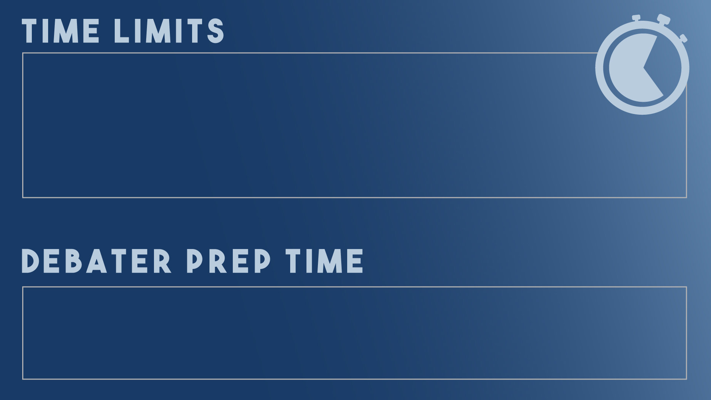
Once time expires, a debater may complete a sentence, but should not start a new thought.
Once time expires, judges should disregard the additional comments and content when evaluating the round.
Each debater has a total of 4 minutes for preparation between speeches.

Slide 17
Flowing organizes the ideas in a round.
Use flow sheets or plain paper.
Not to be turned in.
Optional! Just a tool to help you.
The right note-taking system allows you to:
Absorb the presentation.
Follow an argument as it’s developed.
Track responses & refutation.
Give the debaters written feedback.

Slide 20
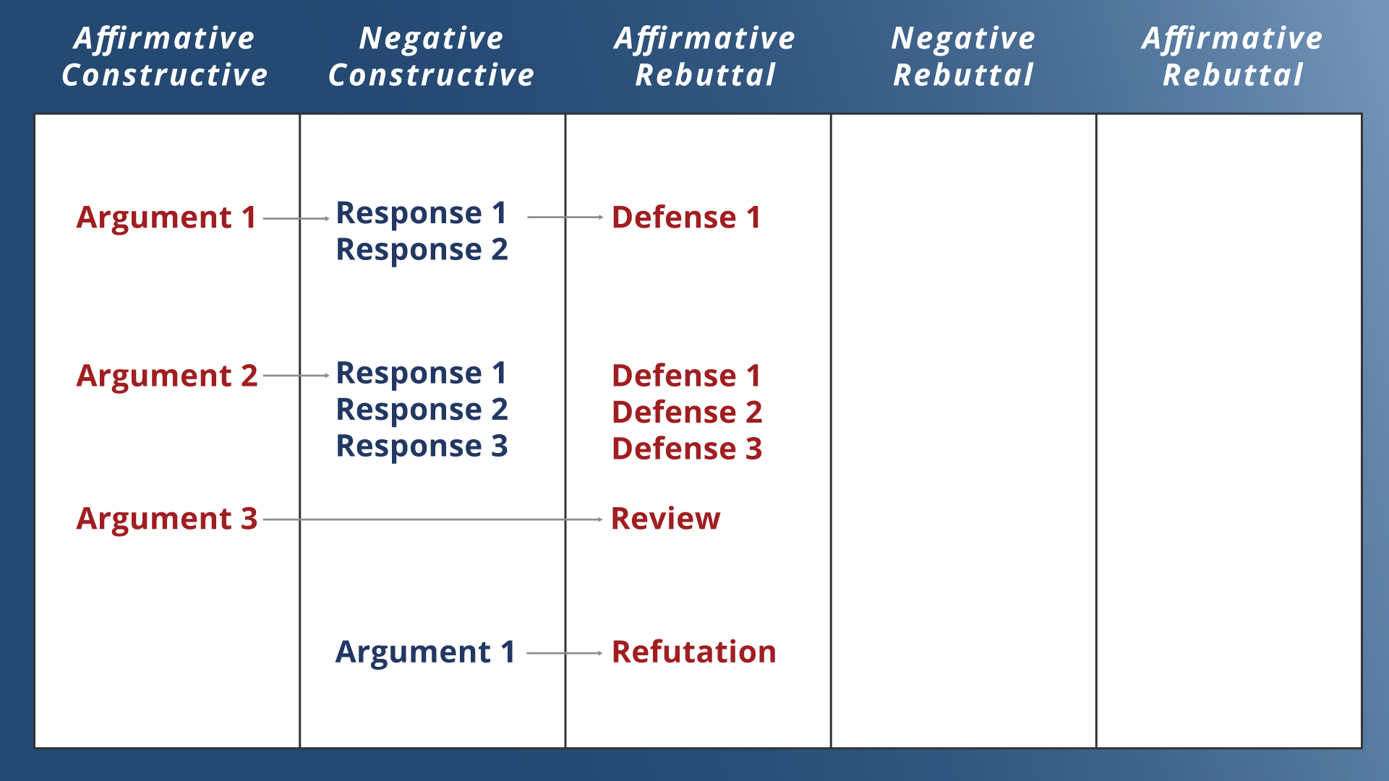

Slide 21
The debaters are responsible for making their ideas clear to the judge, including:
Debate theory.
Organization of the ideas and arguments in the round.
Details of the topic.
It’s up to the debaters to persuade you how to vote, and why.

Slide 23
Do set aside your personal bias.
Do decide which debater best supports his or her position.
Do provide written feedback.

Slide 24
DON’T interrupt or question the debaters during the round.
DON’T leave the room, text, or take phone calls during the round.
DON’T discuss the round with the debaters, audience or other judges when it is finished.

Slide 25
Confirm you have not judged either debater in this event at this tournament.
Make sure the tournament staff know which ballot you have.
Find the room number (top right).
Fill in your name (if needed).

Slide 26
Two independent decisions:
Decide which side wins.
Arguments are more important than presentation; the team with lower points may still win the round.
Evaluate and reward individual presentation.
Assign each debater points based on their personal performance in the round.
Set aside personal bias and opinions during this process.

Slide 27
Assign 1-5 in each category.
Add up point total.
Points may be tied; ties are broken with rank.
Lower point total may win the round.
Rank debaters sequentially by points.
highest number = 1st rank;
lowest number = 2nd rank.
Leave positive and constructive feedback for the students to read.
all debaters will see what you wrote.

Slide 28
Vote Affirmative or Negative.
double loss is disciplinary.
The team with lower point totals may win.
argument is more important than presentation.
Explain why you voted the way you did.
students read these comments to learn what
they can improve/change next time.
Use the back of the ballot for extra space to write your thoughts.
this will be photocopied for both teams.

Slide 29
Best demonstrated the validity of their argument(s),
and,
Best refuted the arguments raised by the other team.
One team may allege that they other side broke a rule, or you may notice a rule violation yourself. You may cast a vote against the offending team, or reduce their points, based solely on the infraction.
The team who debated best may lose the round if they broke a rule.
* Please consult a written copy of the rules before making this decision. *

Slide 30
Judge the round based solely upon the issues discussed in the round.
Be impartial: set aside your personal biases and opinions.
Be prepared to vote for a position you do not personally hold.

Slide 31
Only pertinent information needed for tabulation purposes.
Vote Affirmative or Negative.
Provide total individual points.
Rank debaters.
Turn in as soon as possible.
Continue filling out the main ballot with comments and reason for decision!

Slide 32
The debaters may thank you for your time judging today.
Do not disclose your decision.
Do not ask questions about the round or give verbal feedback.
Do not solicit opinions about the round from others in the room.
Immediately following the round, take your ballot(s) to the designated area for completion.

Slide 33
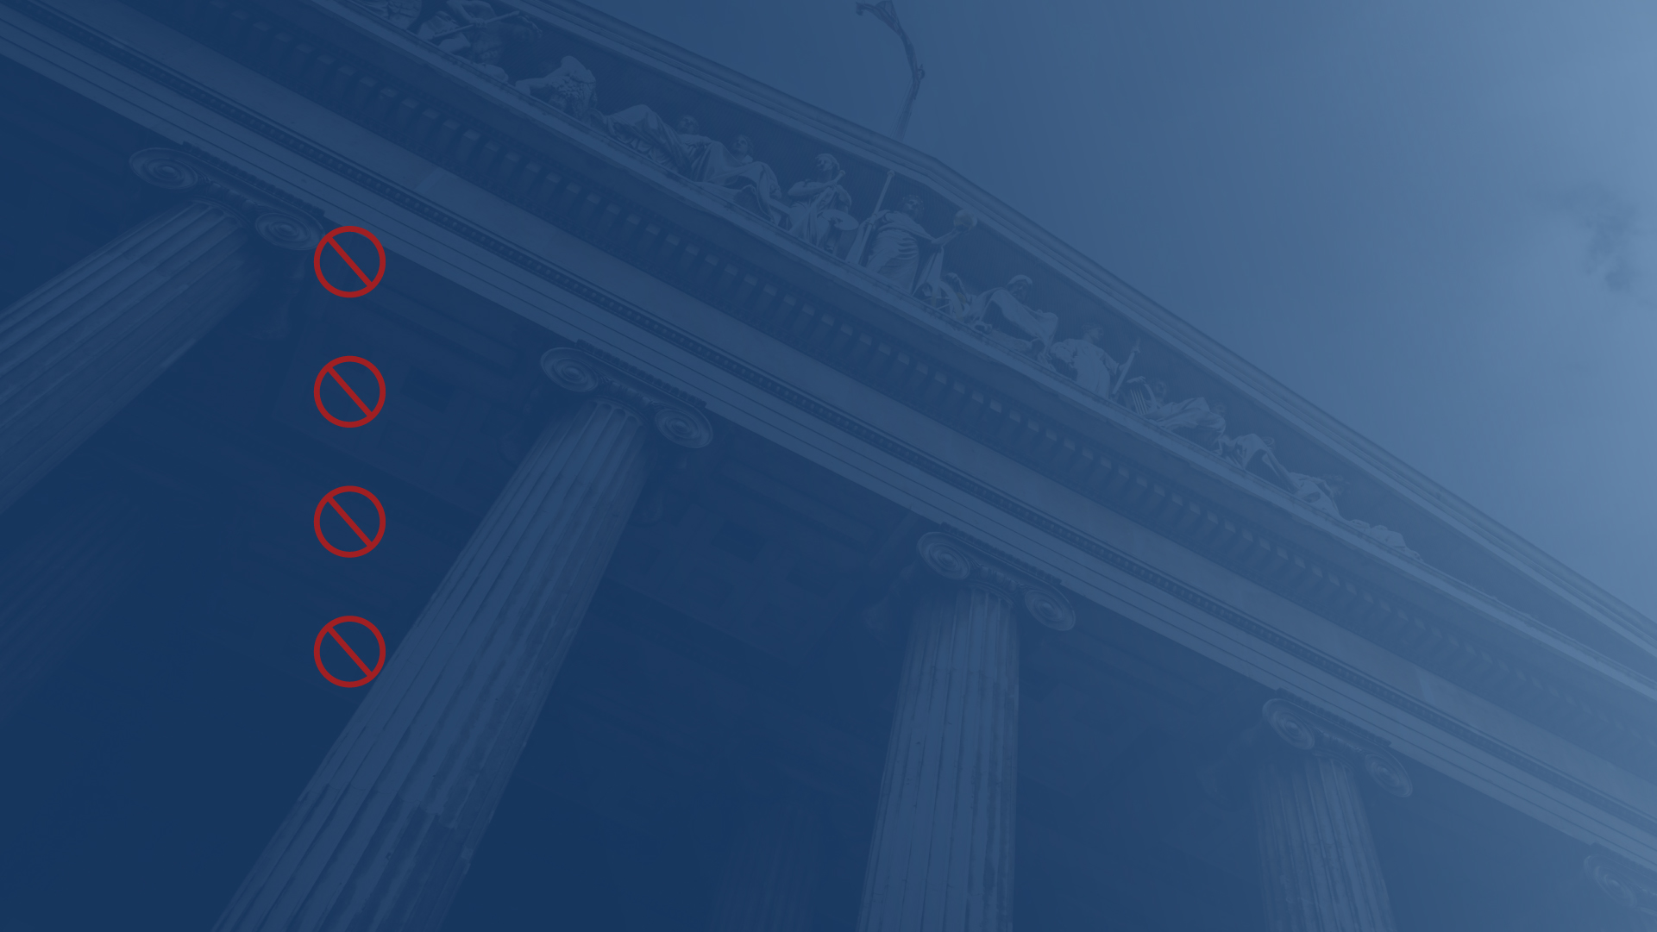
Judges should not:
Fact check debaters after the round.
Take photos of evidence.
Record rounds.
Livestream or post rounds on social media.
You are always welcome to take notes, review rules, and share any concerns with the tournament leadership after the round.

Slide 34
If you have questions concerning the round or your ballot, staff is available to answer your questions in the judge’s area.
Were the rules discussed in your round? Unsure what they are?
A written copy of the rules are available for review.

